Slide 1

Lexical Analyzer
By Abdullah Banafea

Slide 2
A lexical analyzer, is a program component that breaks down a source code file into a sequence of tokens. It is the first phase of a compiler or interpreter, and its main task is to read the input source code and produce a stream of tokens that can be processed by the next phase of the compiler. The lexical analyzer scans the source code file character by character, grouping them into meaningful units called tokens. These tokens represent the basic building blocks of the programming language, such as keywords, identifiers, operators, and literals. The lexer also discards any comments or whitespace characters that are not relevant to the program's execution. The output of the lexical analyzer is a stream of tokens that are passed on to the next phase of the compiler, which is usually the parser. The parser then uses these tokens to build a parse tree, which represents the syntactic structure of the program.
Lexical analyzer

Slide 3
Methods And Variables
Variable for the input: code
Another variables:
operators
punctuators
Method: lexeme()
Variables:
lexeme_count
class_char, lex, tok, consumed
Method: lex_num()
Variables: num
Method: lex_id()
Variables: id
Method:lex_op()
Variables: operators, op

Slide 4
Methods And Variables
Method: lex_pun()
Variables: punctuators, p
Method: get_char()
Variables: char

Slide 5
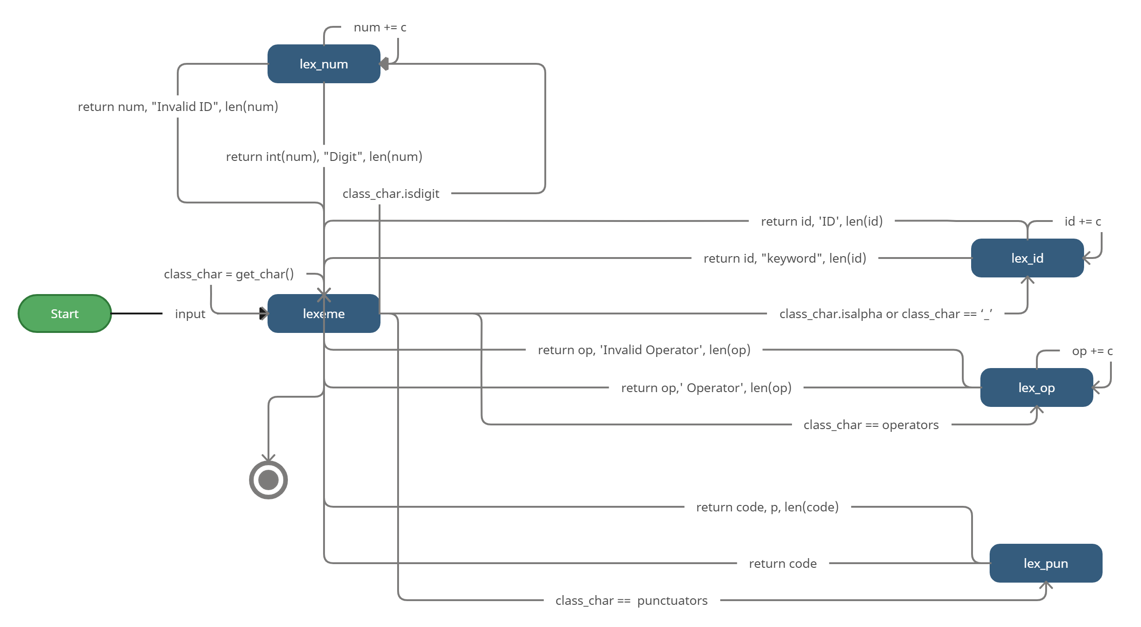

Slide 6
Lexical Analyzer
Thank You

